Slide 1
Objectives
In this session, you will learn to:
  Query data by using joins

Slide 2

Querying Data by Using Joins
What are Joins?

Slide 3
Querying Data by Using Joins (Contd.)
Joins:
  Allow to retrieve data from multiple tables.
  Can be of the following types:
    Inner join
    Outer join
    Cross join
    Equi join
    Self join
Notes:
Student already have learnt about type 2 SCDs in Module I. Therefore, you can start this topic by asking the following questions to students:
What are type 2 SCDs?
Given an example to explain type 2 SCDs.
This will recapitulate what they have learnt about type 2 SCD in Module 1.
Now explain the strategy to update the data into these dimension tables with help the example given in SG.
After explaining the examples, you can ask students to think of an example of a type 2 SCD and then tell the strategy to update the data into this dimension table.

Slide 4
Using an Inner Join
Inner join:
  Retrieves records from multiple tables after comparing values present in a common column.
  Retrieves only those rows that satisfy the join condition.
  Syntax:
    SELECT column_name, column_name [,column_name]
    FROM table1_name JOIN table2_name
    ON table1_name.ref_column_name join_operator table2_name.ref_column_name
Notes:
Student already have learnt about type 2 SCDs in Module I. Therefore, you can start this topic by asking the following questions to students:
What are type 2 SCDs?
Given an example to explain type 2 SCDs.
This will recapitulate what they have learnt about type 2 SCD in Module 1.
Now explain the strategy to update the data into these dimension tables with help the example given in SG.
After explaining the examples, you can ask students to think of an example of a type 2 SCD and then tell the strategy to update the data into this dimension table.

Slide 5

Using an Inner Join (Contd.)
Let us now understand the working of inner join.

Slide 6
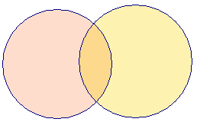
Using an Inner Join (Contd.)
COLUMNS
COLUMNS
    A B C
    B D E
    Table X
    Table Y
    INNER JOIN
    A B C D E
    COMMON ROWS
OUTPUT
Notes:
Explain the diagram to the students. Tell them that, in the above diagram you can see that the common data from both the tables, Table X and Table Y is displayed. The data is displayed on the base of a common column, Column B.

Slide 7
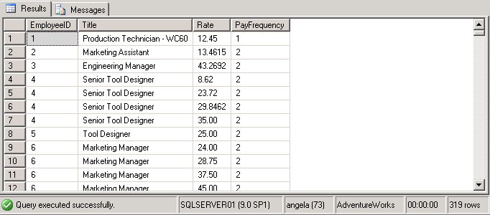
Using an Inner Join (Contd.)
  For example:
    SELECT e.EmployeeID,e.Title, eph.Rate,eph.PayFrequency
    FROM HumanResources.Employee e JOIN HumanResources.EmployeePayHistory eph ON e.EmployeeID = eph.EmployeeID
Output
Employee table
EmployeePayHistory table
Notes:
You can summarize the session by running through the summary given in SG.
In addition, you can also ask students summarize what they have learnt in this session.

Slide 8
Using an Inner Join (Contd.)
An inner join is the default join. Therefore, you can also apply an inner join by using the JOIN keyword.

Slide 9
Just a minute
Why do you need a table alias with the column name?
Solution:
  A table alias is required to uniquely identify columns in the SELECT query to avoid ambiguity that arises due to same column names in multiple tables.
Notes:
Student already have learnt about type 2 SCDs in Module I. Therefore, you can start this topic by asking the following questions to students:
What are type 2 SCDs?
Given an example to explain type 2 SCDs.
This will recapitulate what they have learnt about type 2 SCD in Module 1.
Now explain the strategy to update the data into these dimension tables with help the example given in SG.
After explaining the examples, you can ask students to think of an example of a type 2 SCD and then tell the strategy to update the data into this dimension table.

Slide 10
Using an Outer Join
Outer join:
  Displays the result set containing all the rows from one table and the matching rows from another table.
  Displays NULL for the columns of the related table where it does not find matching records.
  Is of the following types:
    Left outer join
    Right outer join
    Full outer join
Notes:
Student already have learnt about type 2 SCDs in Module I. Therefore, you can start this topic by asking the following questions to students:
What are type 2 SCDs?
Given an example to explain type 2 SCDs.
This will recapitulate what they have learnt about type 2 SCD in Module 1.
Now explain the strategy to update the data into these dimension tables with help the example given in SG.
After explaining the examples, you can ask students to think of an example of a type 2 SCD and then tell the strategy to update the data into this dimension table.

Slide 11
Using an Outer Join (Contd.)
Let us now understand how different types of outer join works.

Slide 12
Using an Outer Join (Contd.)
COLUMNS
COLUMNS
    A B C
    B D E
    Table X
    Table Y
    LEFT OUTER JOIN
    A B C D E
    ALL ROWS FROM TABLE X AND COMMON ROWS FROM TABLE Y
OUTPUT
Notes:
Explain the concept of the LEFT OUTER JOIN to the students using the diagram. Tell them, that as shown in the figure all the rows from first table, Table X are displayed. However, only the matching rows from the second table, Table Y, are displayed. Also tell them that the data is based on the common column between the tables, Column B.

Slide 13
Using an Outer Join (Contd.)
COLUMNS
COLUMNS
    A B C
    B D E
    Table X
    Table Y
    RIGHT OUTER JOIN
    A B C D E
    ALL ROWS FROM TABLE Y AND COMMON ROWS FROM TABLE X
OUTPUT
Notes:
Explain the concept of the RIGHT OUTER JOIN to the students using the diagram. Tell them, that as shown in the figure all the rows from second table, Table Y are displayed. However, only the matching rows from the first table, Table X, are displayed. Also tell them that the data is based on the common column between the tables, Column B.

Slide 14
Using an Outer Join (Contd.)
COLUMNS
COLUMNS
    A B C
    B D E
    Table X
    Table Y
    FULL OUTER JOIN
    A B C D E
    ALL ROWS FROM TABLE Y AND TABLE Y AND COMMON ROWS ONLY ONCE
OUTPUT
Notes:
Explain the concept of the FULL OUTER join to the students. Tell them that full outer join is a combination of LEFT OUTER join and RIGHT OUTER join. This join returns all the matching and non-matching rows from both the tables.

Slide 15
Using an Outer Join (Contd.)
  Syntax:
    SELECT column_name, column_name [,column_name]
    FROM table1_name [LEFT | RIGHT| FULL] OUTER JOIN table2_name ON table1_name.ref_column_name join_operator table2_name.ref_column_name
Notes:
Student already have learnt about type 2 SCDs in Module I. Therefore, you can start this topic by asking the following questions to students:
What are type 2 SCDs?
Given an example to explain type 2 SCDs.
This will recapitulate what they have learnt about type 2 SCD in Module 1.
Now explain the strategy to update the data into these dimension tables with help the example given in SG.
After explaining the examples, you can ask students to think of an example of a type 2 SCD and then tell the strategy to update the data into this dimension table.

Slide 16
Using an Outer Join (Contd.)
Left outer join:
  Returns all rows from the table specified on the left side of the LEFT OUTER JOIN keyword and the matching rows from the table specified on the right side.
  Displays NULL for the columns of the table specified on the right side where it does not find matching records.
  For example:
    SELECT p.ProductID, p1.SalesOrderID, p1.UnitPrice FROM Sales.SpecialOfferProduct p LEFT OUTER JOIN
    [Sales].[SalesOrderDetail] p1 ON p. ProductID = p1.ProductID WHERE SalesOrderID IS NULL
Notes:
Student already have learnt about type 2 SCDs in Module I. Therefore, you can start this topic by asking the following questions to students:
What are type 2 SCDs?
Given an example to explain type 2 SCDs.
This will recapitulate what they have learnt about type 2 SCD in Module 1.
Now explain the strategy to update the data into these dimension tables with help the example given in SG.
After explaining the examples, you can ask students to think of an example of a type 2 SCD and then tell the strategy to update the data into this dimension table.

Slide 17
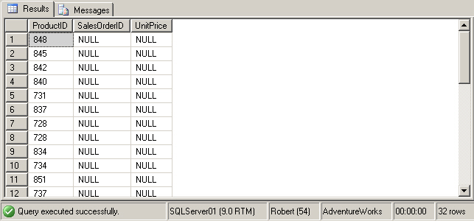
Using an Outer Join (Contd.)
  The following figure displays the output of the preceding query.
Displays NULL for the ProductIDs for which no transaction was performed
Notes:
Student already have learnt about type 2 SCDs in Module I. Therefore, you can start this topic by asking the following questions to students:
What are type 2 SCDs?
Given an example to explain type 2 SCDs.
This will recapitulate what they have learnt about type 2 SCD in Module 1.
Now explain the strategy to update the data into these dimension tables with help the example given in SG.
After explaining the examples, you can ask students to think of an example of a type 2 SCD and then tell the strategy to update the data into this dimension table.

Slide 18
Using an Outer Join (Contd.)
Right outer join:
  Returns all the rows from the table specified on the right side of the RIGHT OUTER JOIN keyword.
  Returns the matching rows from the table specified on the left side.
  For example:
    SELECT e.Title, d.JobCandidateID FROM HumanResources.Employee e
    RIGHT OUTER JOIN HumanResources.JobCandidate d ON e.EmployeeID=d.EmployeeID
Notes:
Student already have learnt about type 2 SCDs in Module I. Therefore, you can start this topic by asking the following questions to students:
What are type 2 SCDs?
Given an example to explain type 2 SCDs.
This will recapitulate what they have learnt about type 2 SCD in Module 1.
Now explain the strategy to update the data into these dimension tables with help the example given in SG.
After explaining the examples, you can ask students to think of an example of a type 2 SCD and then tell the strategy to update the data into this dimension table.

Slide 19
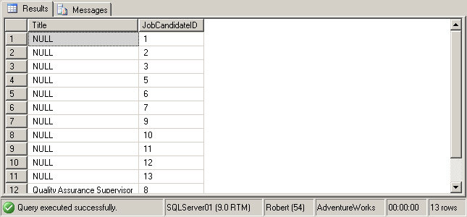
Using an Outer Join (Contd.)
  The following figure displays the output of the preceding query.
Displays the JobCandidateID column from the JobCandidate table and the Title column from the matching rows of the Employee table
Notes:
Student already have learnt about type 2 SCDs in Module I. Therefore, you can start this topic by asking the following questions to students:
What are type 2 SCDs?
Given an example to explain type 2 SCDs.
This will recapitulate what they have learnt about type 2 SCD in Module 1.
Now explain the strategy to update the data into these dimension tables with help the example given in SG.
After explaining the examples, you can ask students to think of an example of a type 2 SCD and then tell the strategy to update the data into this dimension table.

Slide 20
Using an Outer Join (Contd.)
Full outer join:
  Is a combination of left outer join and right outer join.
  Returns all the matching and non-matching rows from both the tables.
  For example:
    SELECT e.EmployeeID, e.EmployeeName, ed.EmployeeEducationCode,
    ed.Education
    FROM Employee e FULL OUTER JOIN Education ed
    ON e.EmployeeEducationCode = ed.EmployeeEducationCode
Notes:
Student already have learnt about type 2 SCDs in Module I. Therefore, you can start this topic by asking the following questions to students:
What are type 2 SCDs?
Given an example to explain type 2 SCDs.
This will recapitulate what they have learnt about type 2 SCD in Module 1.
Now explain the strategy to update the data into these dimension tables with help the example given in SG.
After explaining the examples, you can ask students to think of an example of a type 2 SCD and then tell the strategy to update the data into this dimension table.

Slide 21
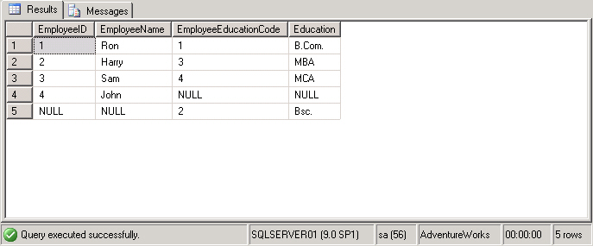
Using an Outer Join (Contd.)
  The following figure displays the output of the preceding query.
  .
The employee details and their highest educational qualification is displayed. For non-matching values, NULL is displayed.
Notes:
Student already have learnt about type 2 SCDs in Module I. Therefore, you can start this topic by asking the following questions to students:
What are type 2 SCDs?
Given an example to explain type 2 SCDs.
This will recapitulate what they have learnt about type 2 SCD in Module 1.
Now explain the strategy to update the data into these dimension tables with help the example given in SG.
After explaining the examples, you can ask students to think of an example of a type 2 SCD and then tell the strategy to update the data into this dimension table.

Slide 22
Just a minute
When do you use the right outer join?
Solution:
  You can use the right outer join when you need all the records from the table at the right side of the outer join and only matching records from the table at the left side of the outer join.
Notes:
Student already have learnt about type 2 SCDs in Module I. Therefore, you can start this topic by asking the following questions to students:
What are type 2 SCDs?
Given an example to explain type 2 SCDs.
This will recapitulate what they have learnt about type 2 SCD in Module 1.
Now explain the strategy to update the data into these dimension tables with help the example given in SG.
After explaining the examples, you can ask students to think of an example of a type 2 SCD and then tell the strategy to update the data into this dimension table.

Slide 23
Using a Cross Join
Cross join:
  Is also known as the Cartesian Product.
  Joins each row from one table with each row of the other table.
Let us now understand the working of cross join.
Notes:
Student already have learnt about type 2 SCDs in Module I. Therefore, you can start this topic by asking the following questions to students:
What are type 2 SCDs?
Given an example to explain type 2 SCDs.
This will recapitulate what they have learnt about type 2 SCD in Module 1.
Now explain the strategy to update the data into these dimension tables with help the example given in SG.
After explaining the examples, you can ask students to think of an example of a type 2 SCD and then tell the strategy to update the data into this dimension table.

Slide 24
Using a Cross Join (Contd.)
COLUMNS
COLUMNS
    A B C
    B D E
    Table X
    Table Y
    CROSS JOIN
m ROWS
n ROWS
    A B C D E
    ALL ROWS (n X m)
    EACH ROW OF TABLE X JOINED WITH EACH ROW OF TABLE Y
OUTPUT
Notes:
Explain the concept of CROSS JOIN to the students. Tell them that CROSS JOIN displays a combination of all the rows from one table with all the rows from the other one. Also tell them that it shows the Cartesian Product between the rows of first and second table.
FAQs
Question: What is the difference between FULL OUTER JOIN and CROSS JOIN?
Answer: A FULL OUTER JOIN displays all matching and non-matching rows from both the tables and displays NULL in place of non-matching rows. Whereas, a CROSS JOIN displays all the possible combination of all the rows in both the tables.
Additional Input
A Cartesian Product is the set of all possible ordered pairs between two sets.

Slide 25
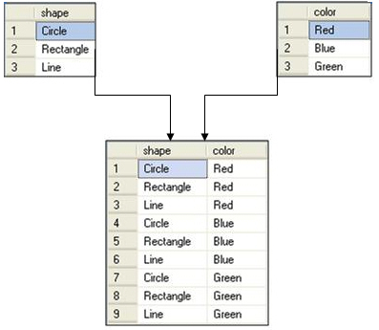
Using a Cross Join (Contd.)
  For example, consider the following figure.
The result set contains nine rows.
Notes:
Student already have learnt about type 2 SCDs in Module I. Therefore, you can start this topic by asking the following questions to students:
What are type 2 SCDs?
Given an example to explain type 2 SCDs.
This will recapitulate what they have learnt about type 2 SCD in Module 1.
Now explain the strategy to update the data into these dimension tables with help the example given in SG.
After explaining the examples, you can ask students to think of an example of a type 2 SCD and then tell the strategy to update the data into this dimension table.

Slide 26
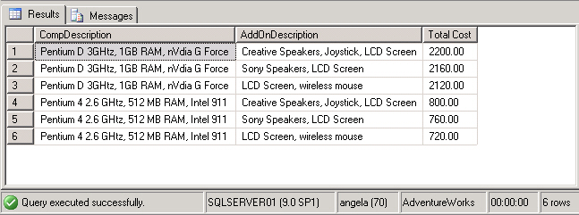
Using a Cross Join (Contd.)
  Consider the following query:
    SELECT A.CompDescription, B.AddOnDescription, A.Price + B.Price AS 'Total Cost' FROM ComputerDetails A CROSS JOIN AddOnDetails B
Output
Combines the records of both the tables to display the total price of a computer with all the possible combinations
Notes:
Student already have learnt about type 2 SCDs in Module I. Therefore, you can start this topic by asking the following questions to students:
What are type 2 SCDs?
Given an example to explain type 2 SCDs.
This will recapitulate what they have learnt about type 2 SCD in Module 1.
Now explain the strategy to update the data into these dimension tables with help the example given in SG.
After explaining the examples, you can ask students to think of an example of a type 2 SCD and then tell the strategy to update the data into this dimension table.

Slide 27
Summary
In this session, you learned that:
  Joins and subqueries are used to retrieve data from multiple tables.
  An inner join combines records from multiple tables by using a comparison operator on a common column.
  A left outer join returns all the rows from the left table and the matching rows from the right table.
  A right outer join returns all the rows from the right table and the matching rows from the left table.
  A full outer join returns all the matching and non-matching rows from both the tables on which join is applied.
  A cross join returns each row from the first table joined with each row from the second table.
Notes:
You can summarize the session by running through the summary given in SG.
In addition, you can also ask students summarize what they have learnt in this session.

